Slide 1


Advertising & Marketing of
Soil Testing and Other Lab Services
Shannon Alford, PhD, Laboratory Director
February 2023

Slide 2

Advertising & Marketing Primer
Disclaimer- I am not a marketing professional! I suggested this topic selfishly.
4 Ps of Marketing
  Product: The thing you are offering in an exchange for money.
    We know what our products (services) are, but what should they be? Survey clientele formally or informally.
  Price: The amount of money you are asking for in exchange for the product. Price is an important factor for marketing because it impacts how customers view your brand. Maserati or Mitsubishi?
  Place: Where your target audience goes to find information about your product. Who is your target audience?
  Promotion: How customers find out about you. This is often done with advertising.
https://asana.com/resources/marketing-vs-advertising-difference

Slide 3
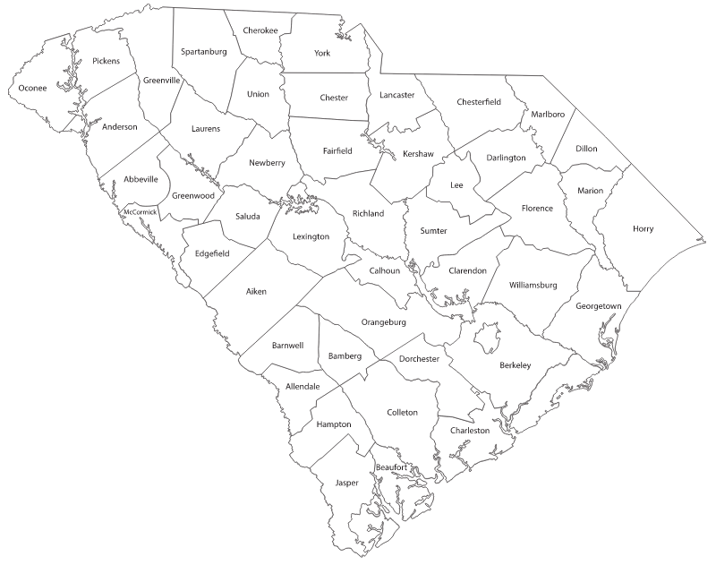
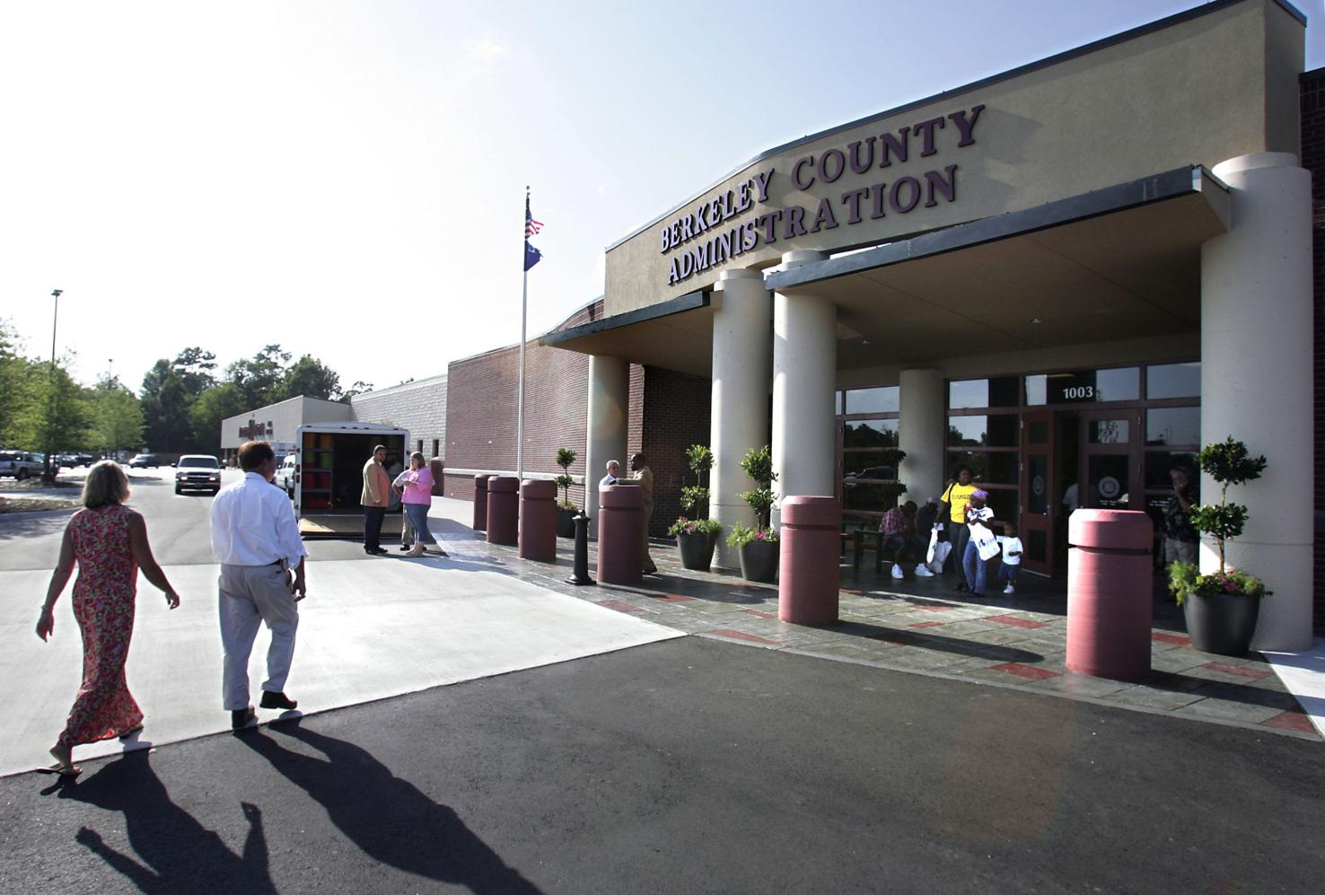

Place: Customers come to us!
Extension Offices: essentially a brick-and-mortar “store” in every county; generally patronized by the regulars; not always in the best location for “business”
https://www.postandcourier.com/archives/clemson-extension-opens-new-office-in-berkeley-county/article_cc87f412-3b3a-58bf-979e-364310ad4761.html

Slide 4
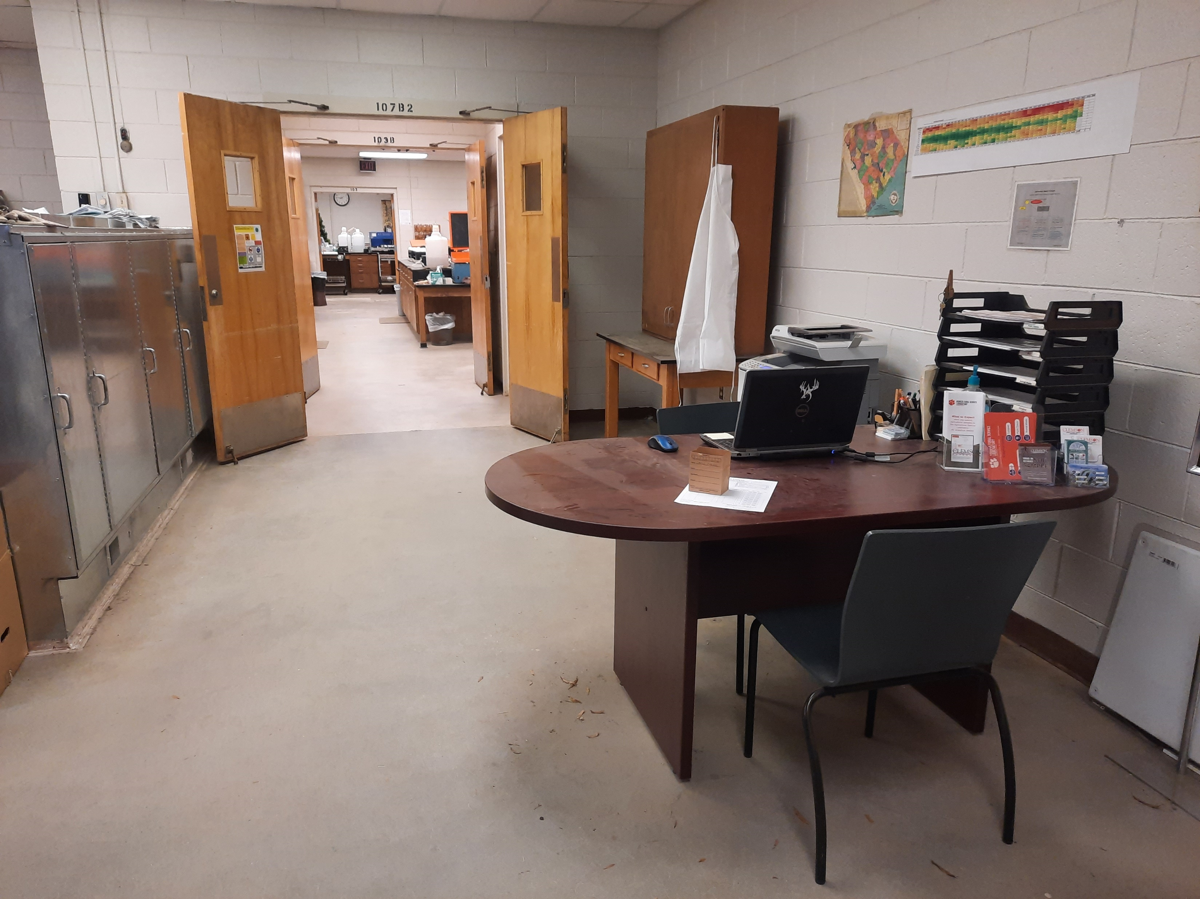
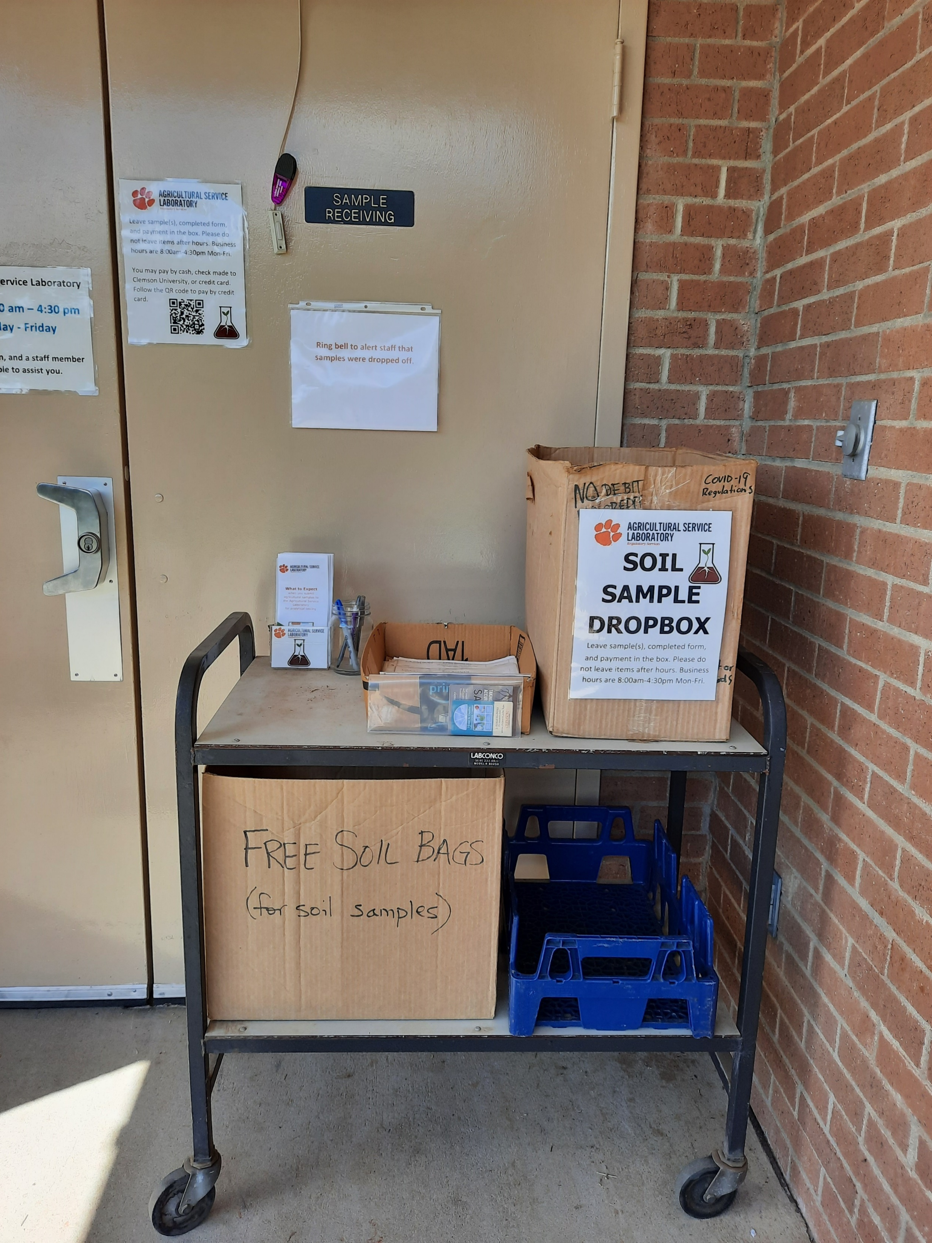
Place: Customers come to us!
Laboratory: direct drop-off; generally patronized by the regulars; not designed for customer interaction; not the best location for “business”

Slide 5
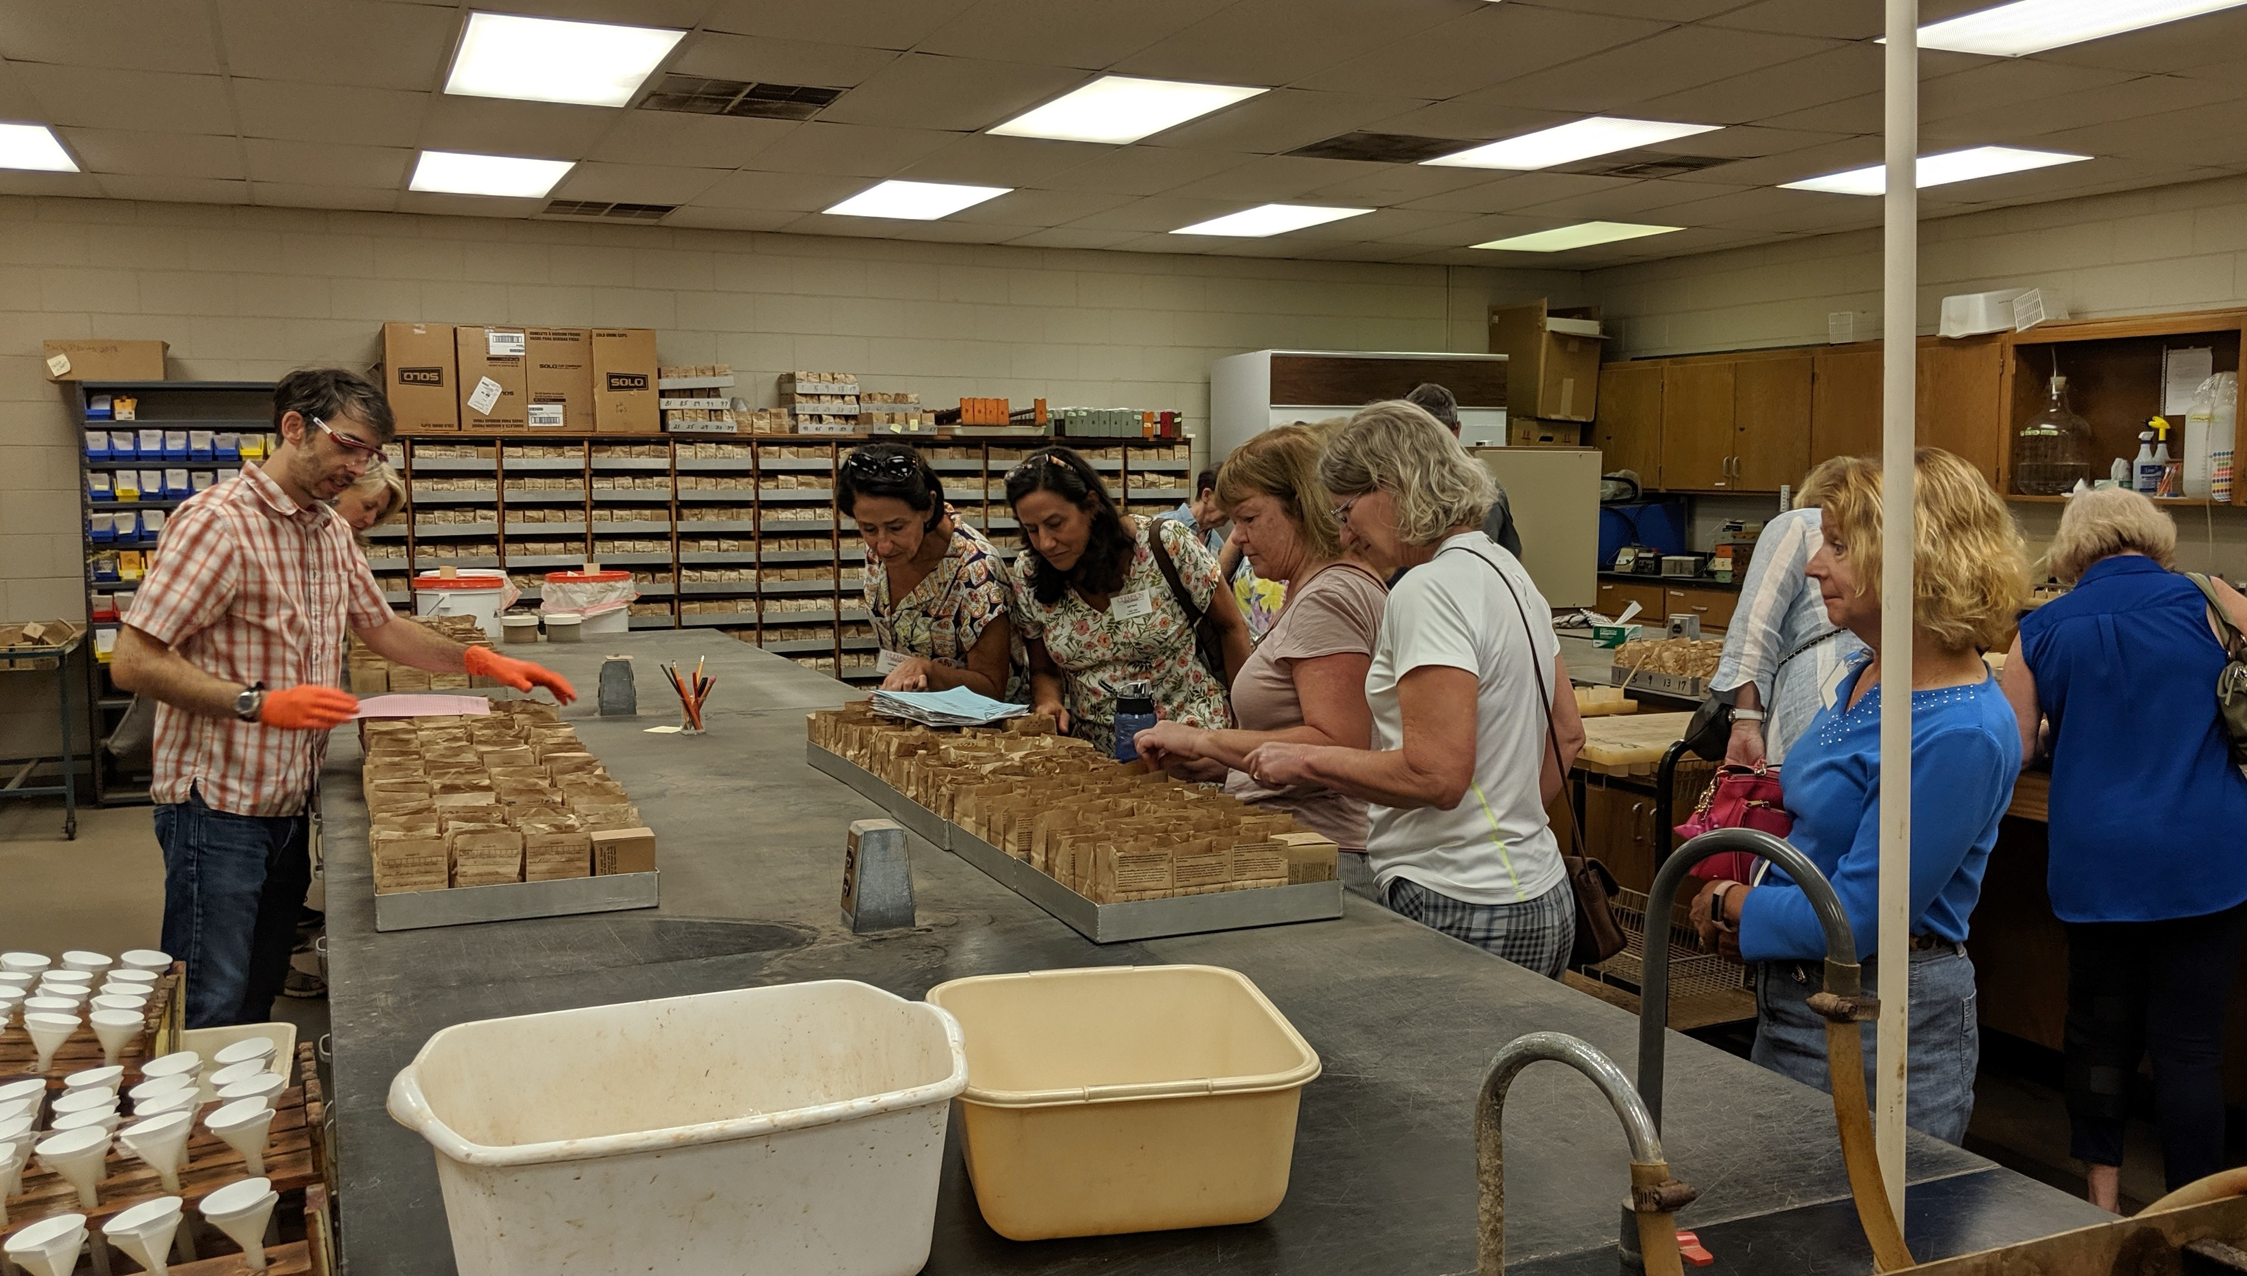
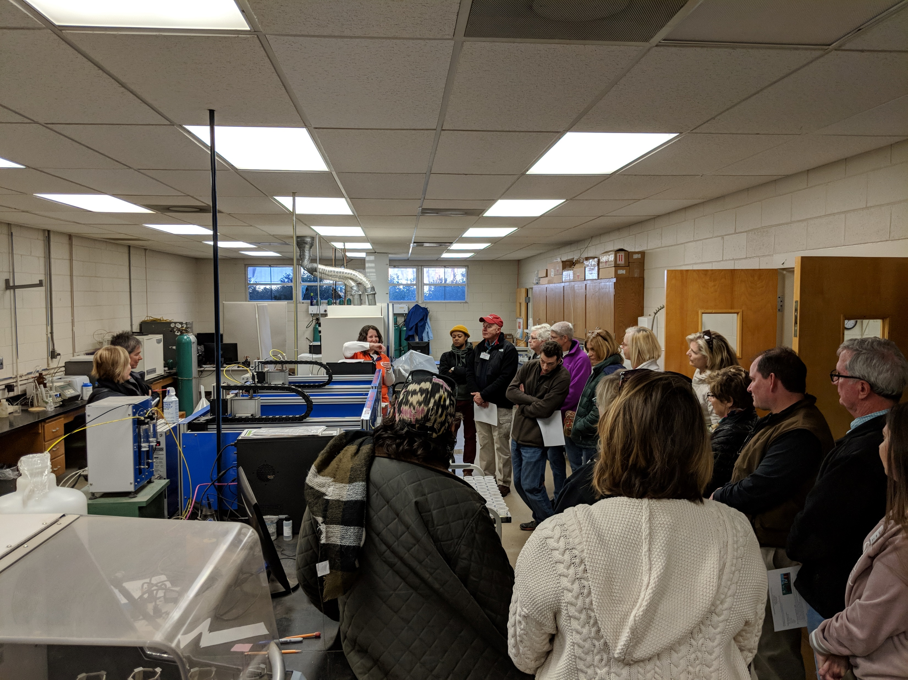
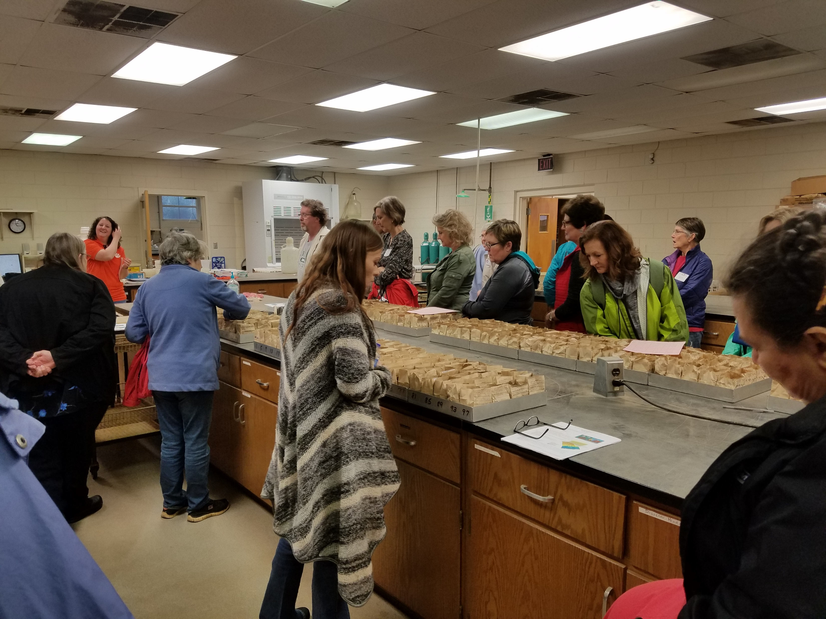
Place: Customers come to us!
Lab Tours
15 lab tours in 2018
16 lab tours in 2019
3 virtual lab tours in 2020
4 lab tours in 2021
11 lab tours for 2022
3 lab tours so far for 2023

Slide 6
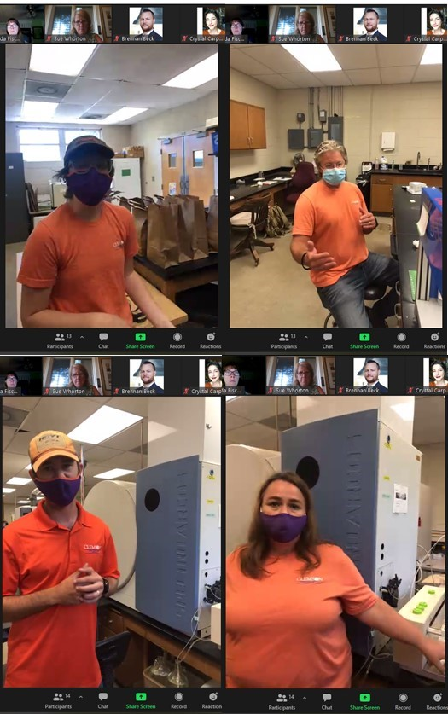
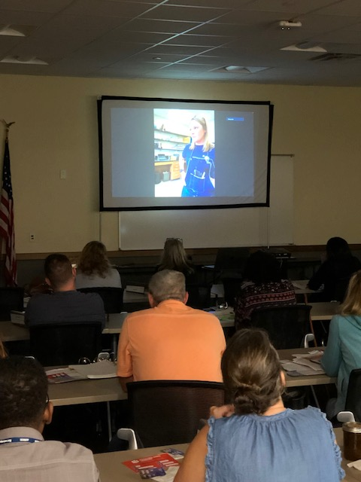
Place: Virtual Tours

Slide 7
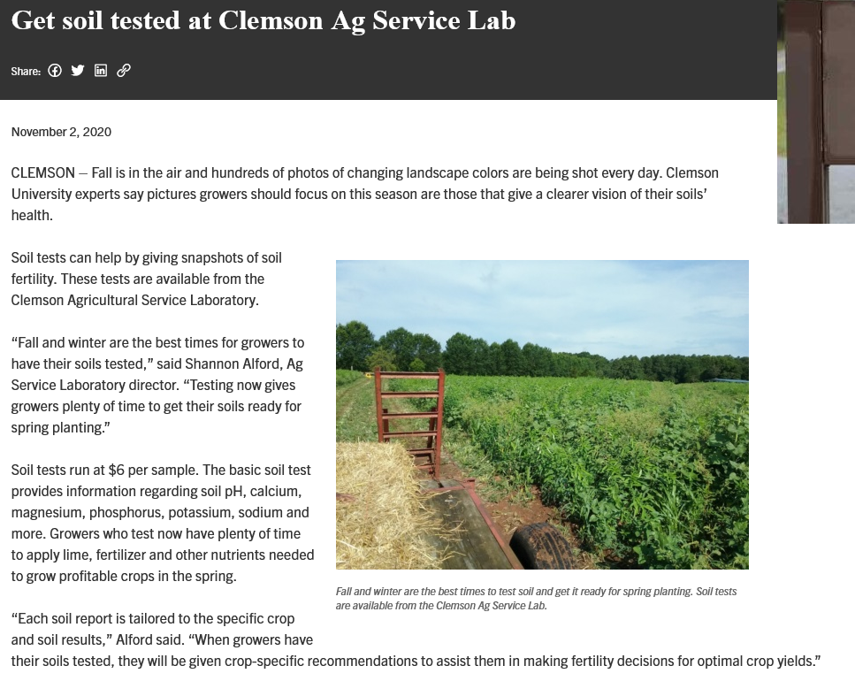
Place and Promotion: Digital Media
Webpage- “brand” dictated by institution; keep updated, but not always timely
News Stories/Blogs- special topics, seasonal; picked up by local and state news agencies; more timely

Slide 8
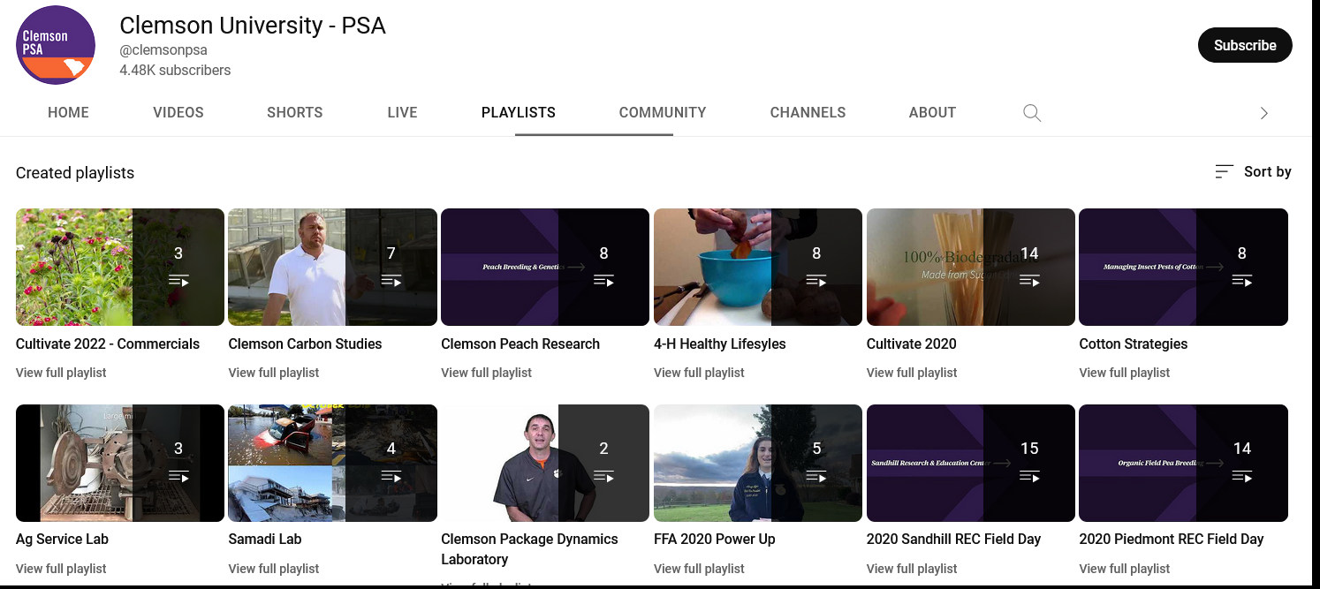
Place and Promotion: Digital Media
Youtube- “brand” dictated by institution and also promoted; more static than social media, so can be used repeatedly

Slide 9
Place and Promotion: Digital Media
Youtube- “brand” dictated by institution and also promoted; more static than social media, so can be used repeatedly
Soil pH Analysis Video

Slide 10
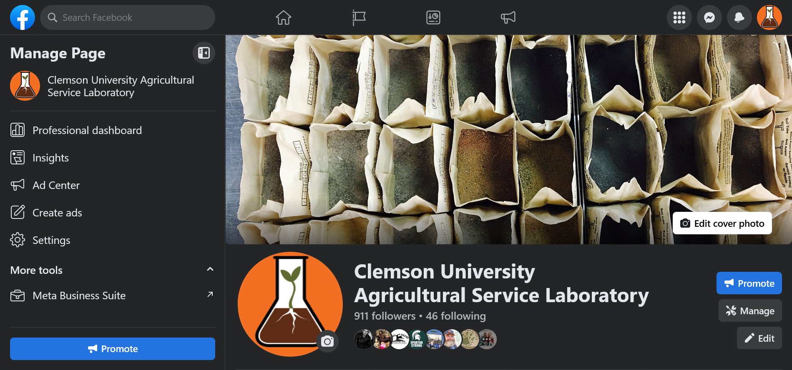
Place and Promotion: Social Media
Facebook- “brand” dictated by institution; more up to date info and advertising than webpages; challenge of regular content creation; can monitor reach

Slide 11
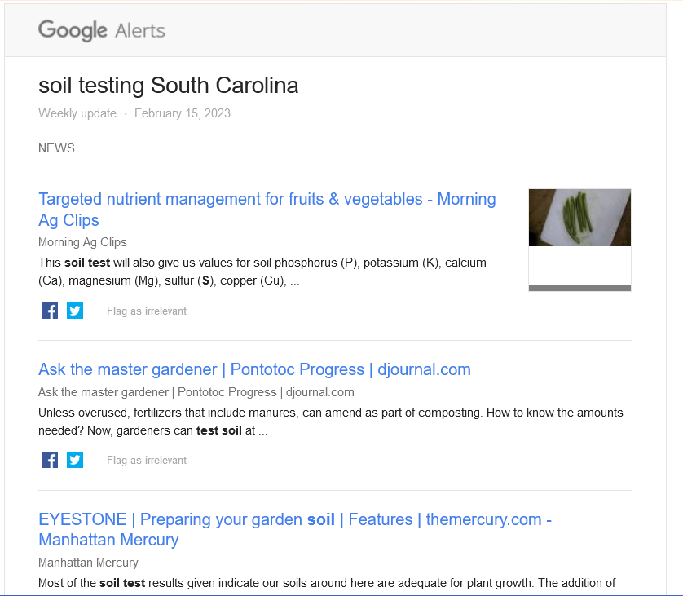
Place and Promotion: Social Media
Content creation
  Fact sheets
  Google alerts (www.google.com/alerts)
  Other related social media pages
  Pictures of people are always favorite posts
  Can schedule in advance, make it seem timely

Slide 12
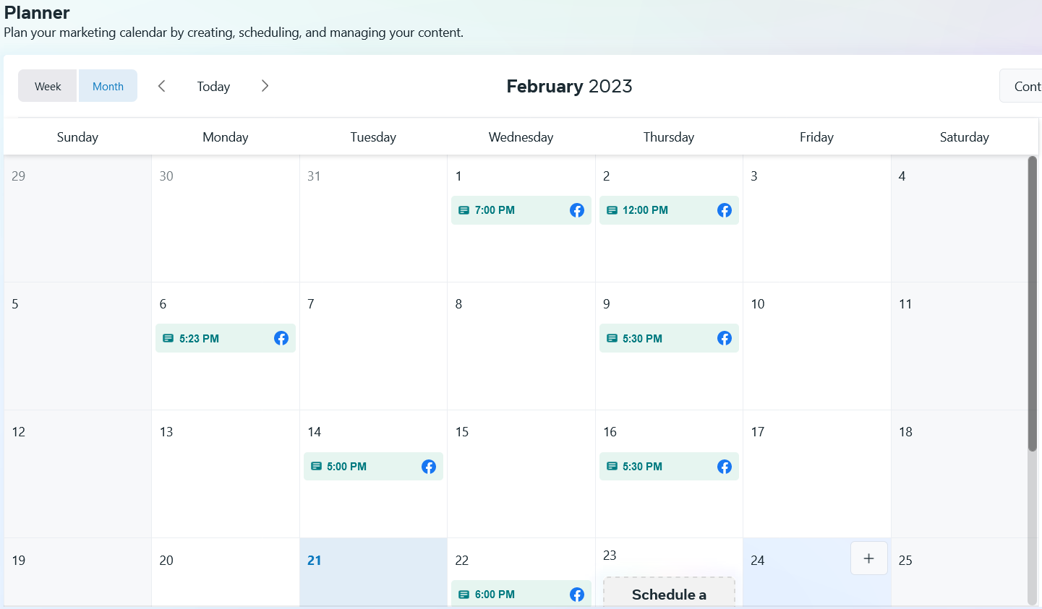
Place and Promotion: Social Media

Slide 13
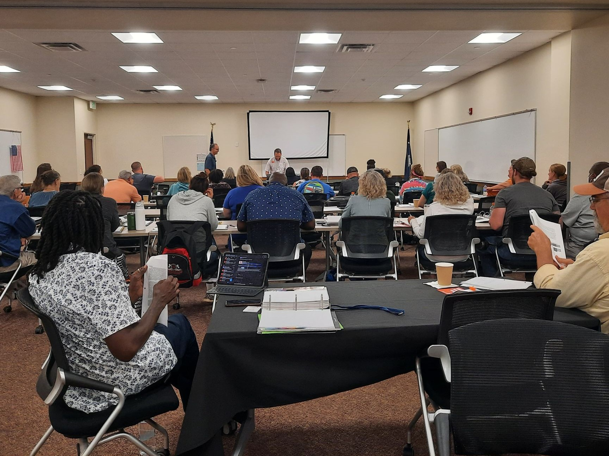
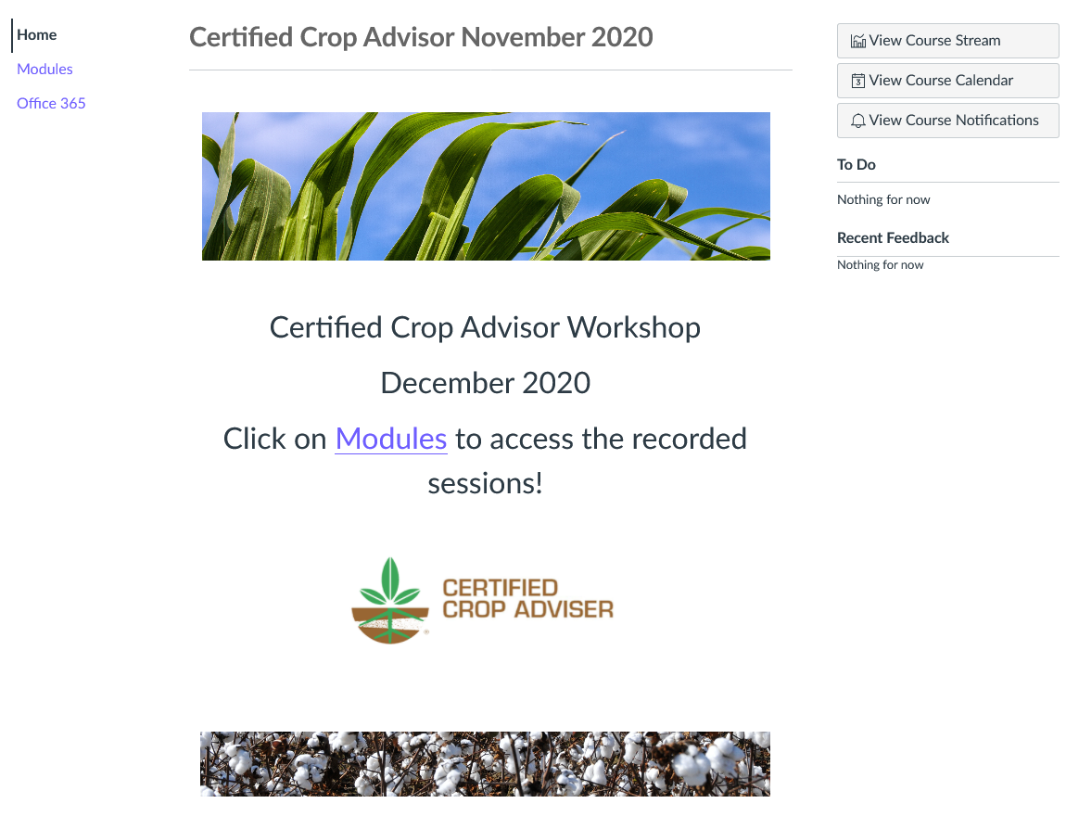
Place and Promotion: Courses
New & Beginning Farmers Program Soil Health Workshop, 2022
CCA Virtual Workshop, 2020 and 2021

Slide 14
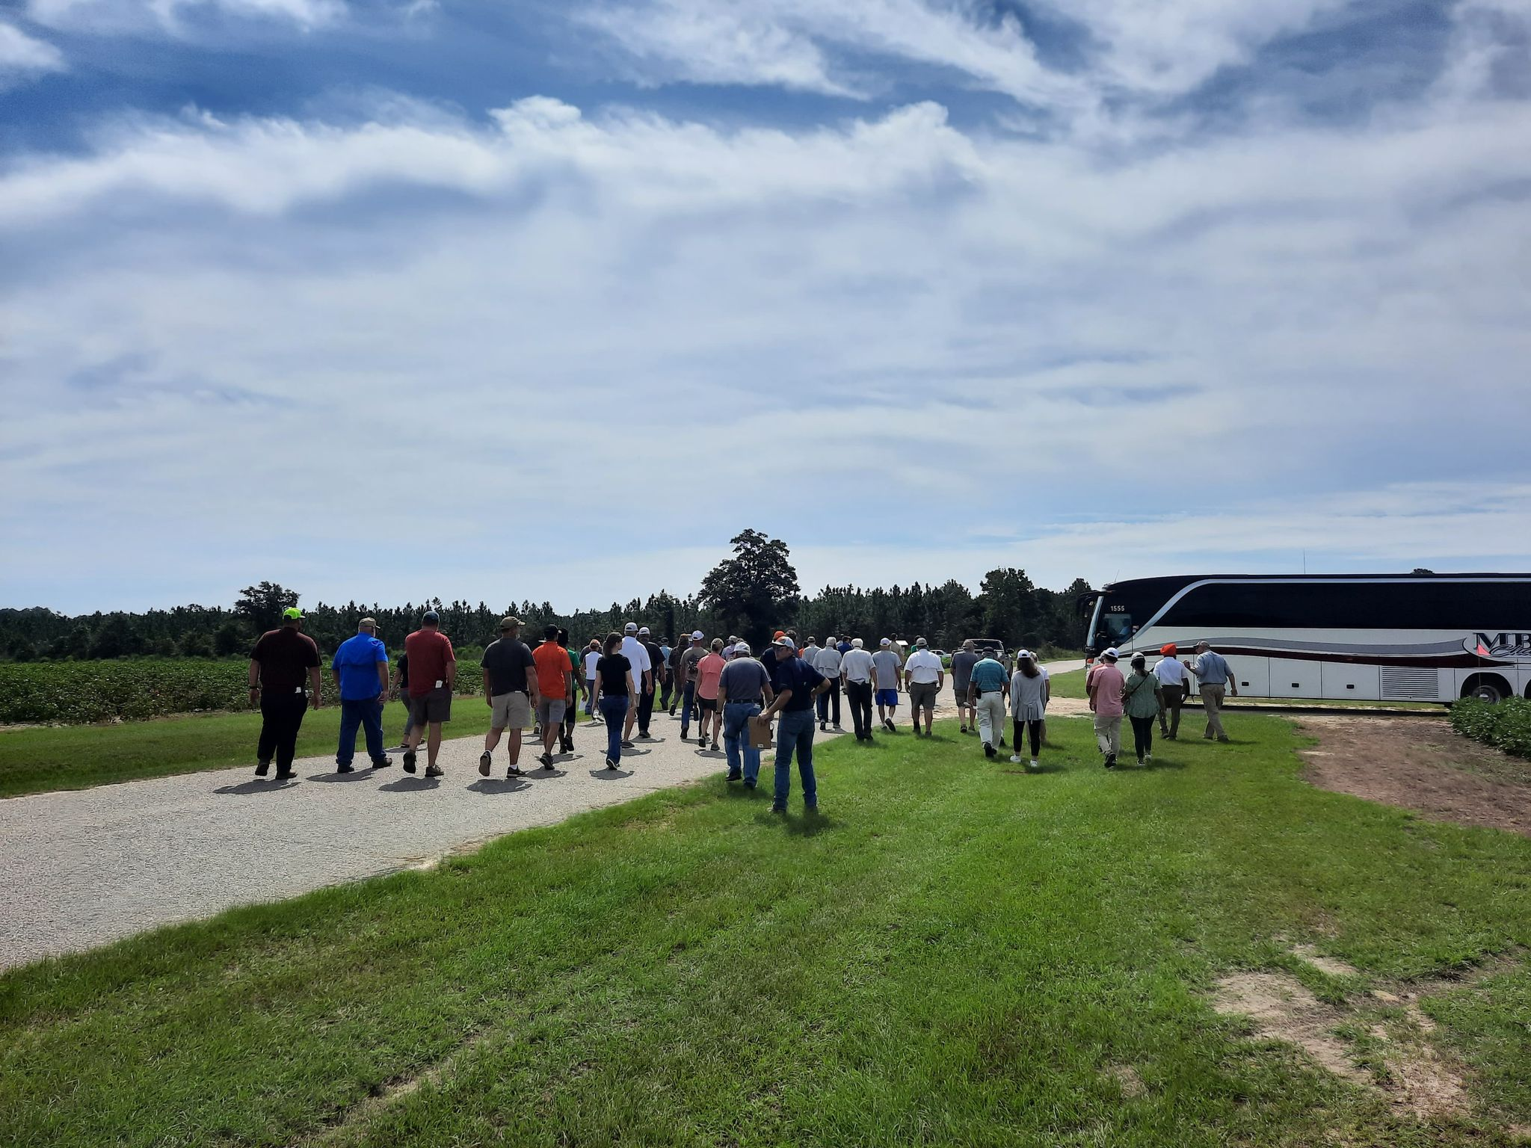
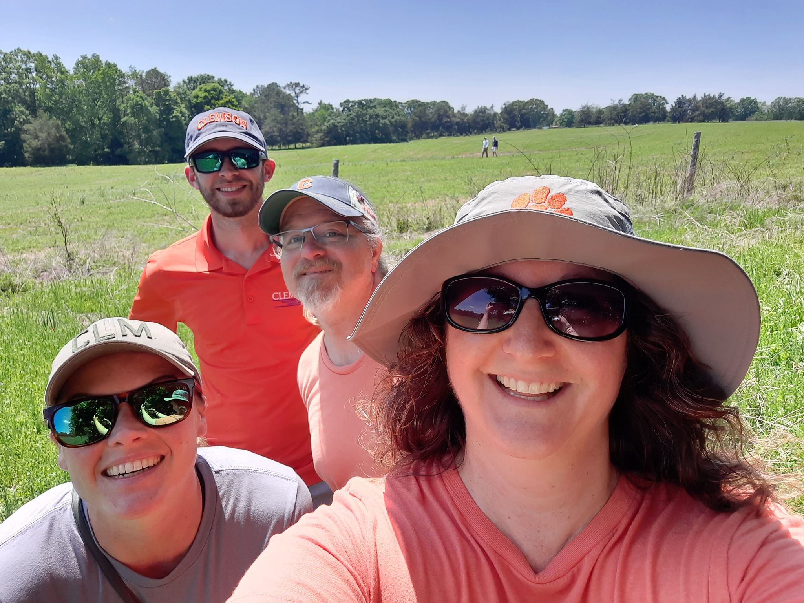
Promotion: Field Days
(dual-use, also staff development)
Pee Dee Rec Field Day, Sept 2022
Alfalfa in the South Field Day, May 2022

Slide 15
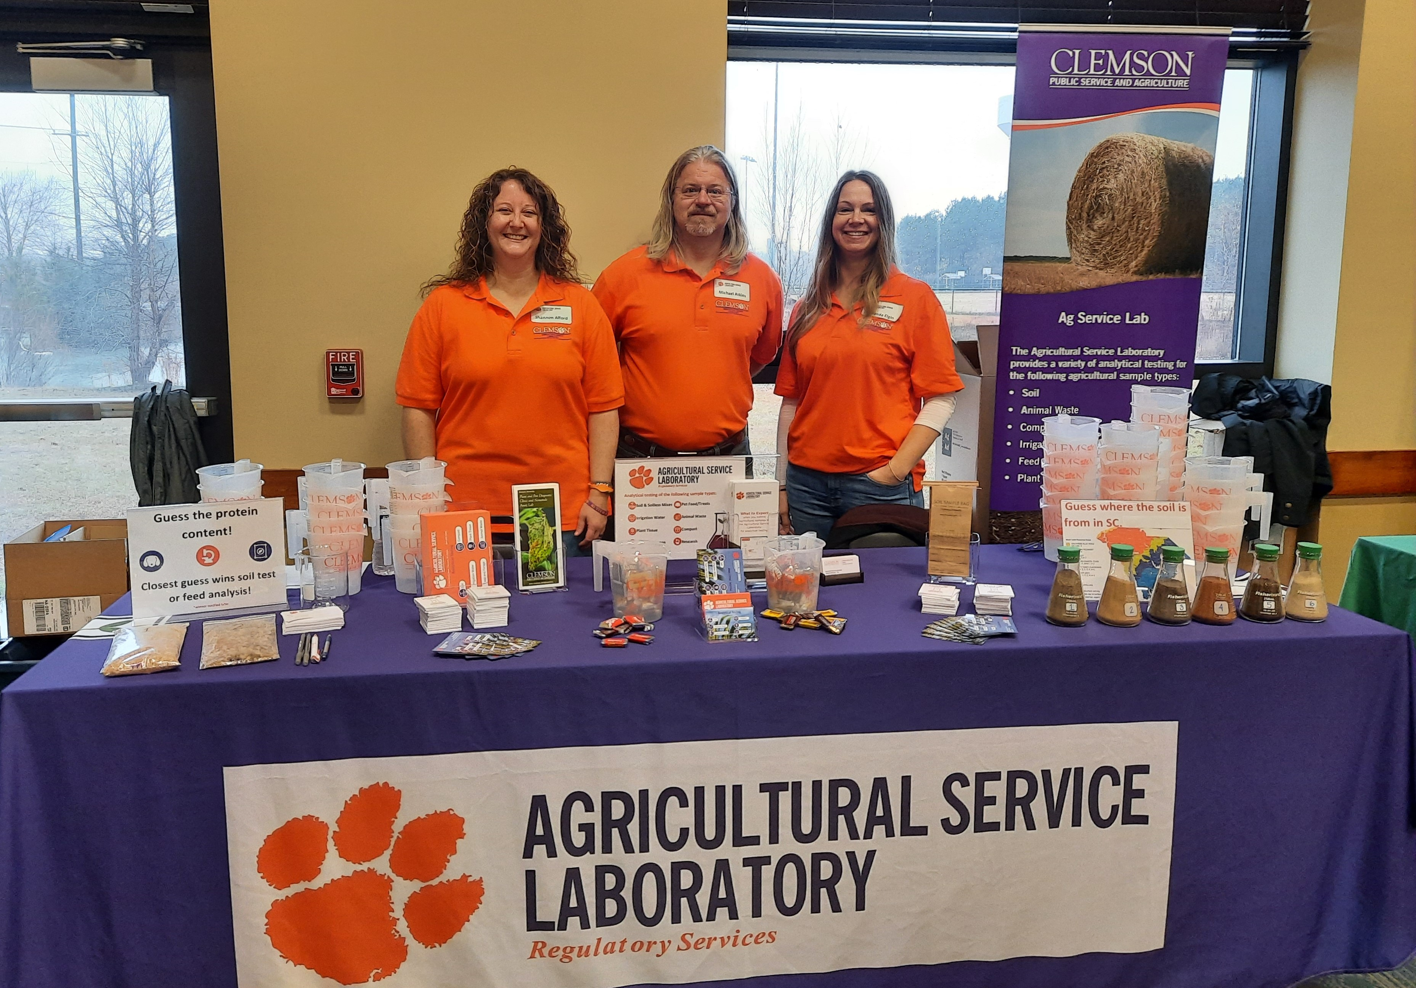
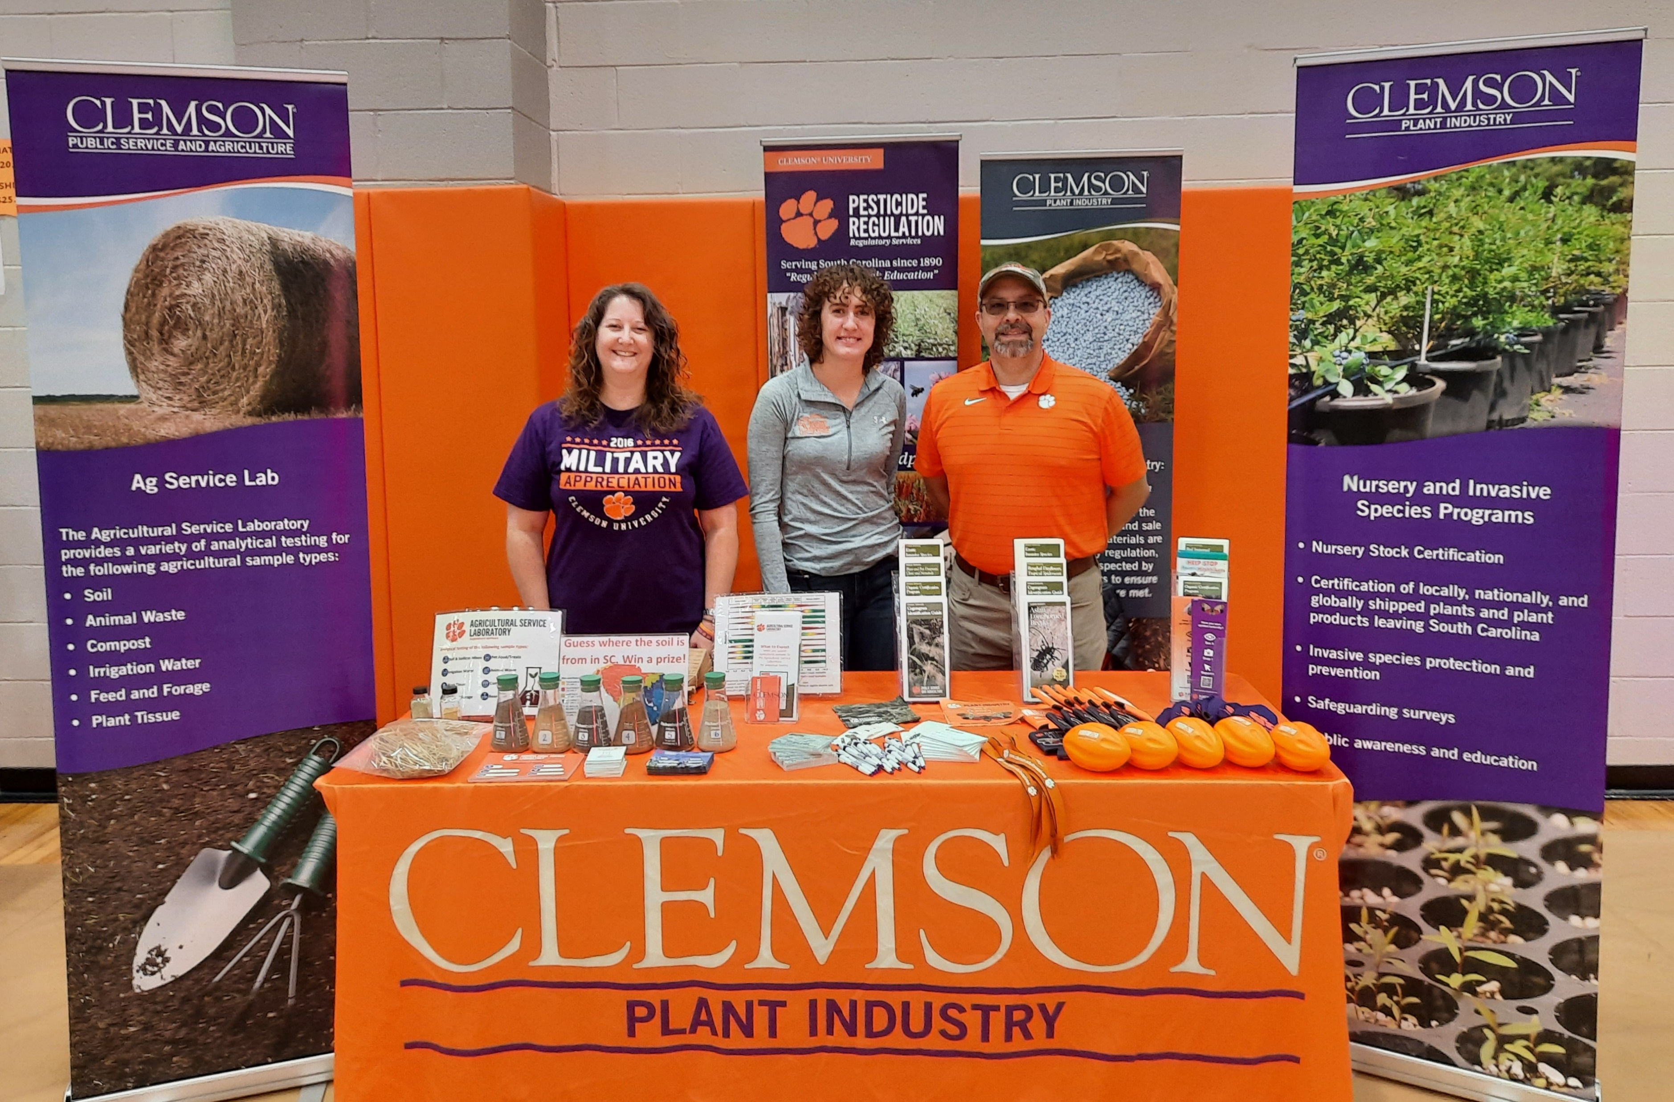
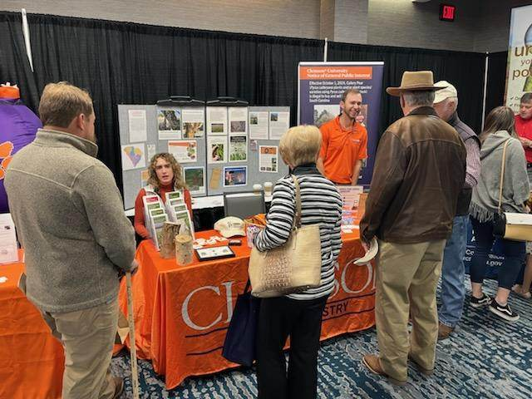
Promotion: Vendor Events
SC Corn and Soybean Growers Meeting, 2021
CAFLS Tailgate, 2021
SC Farm Bureau Meeting, 2022

Slide 16
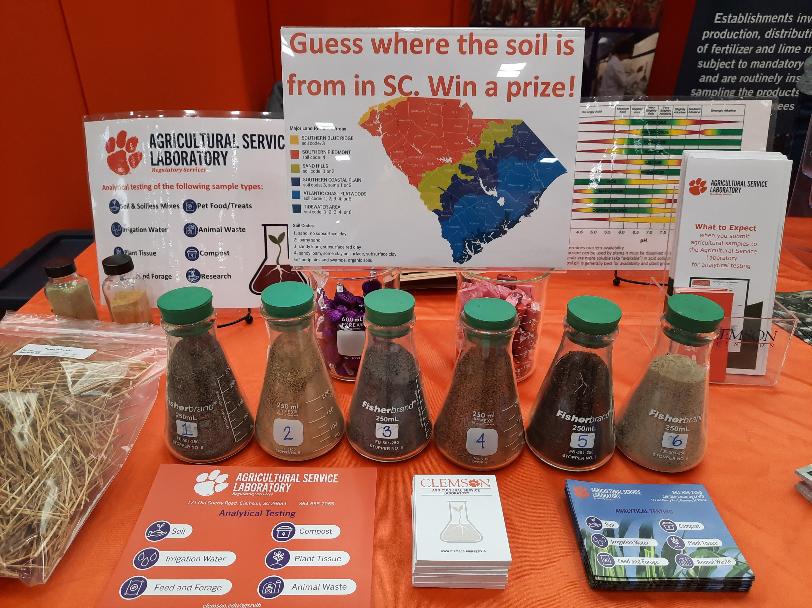
Promotion: Promotional Materials; Swag
Extension Offices and Laboratory display and offer handout materials to in-person visitors.
Primarily, hand out at vendor events.

Slide 17
Questions for Discussion
Why do we need to/should we “advertise” as service labs?
What have you found that works? How do you know it works?
What questions do you have?

